Slide 1
Woodland School District College, Career, and Technical Education
CCTE
Where Community and Learning Connect

Slide 2
What are the components of a CCTE Course
A secondary course which has approved educational frameworks meeting content standards as well as leadership and employability standards
A course taught by a certified CCTE instructor
A course affiliated with a Career and Technical Student Organization (CTSO)
Identified Program of Work for students outside the academic day
The current need for the course as identified by the Washington State “Skills Gap” as defined in RCW 28C.04.100

Slide 3
Steps to CCTE Course Approval
Identify need for course (skills gap, advisory committee)
2. Complete OSPI application for course approval
Course Information (Cluster, Pathway, CIP Code)
Leadership (activities outside the academic day)
Sequence of courses
Frameworks (curriculum map including common core and leadership standards)
Skills Gap
3. Receive approval from program supervisor of the course pathway
4. Advisory approval

Slide 4
Career clusters
Agriculture, Food & Natural Resources
Architecture and Construction
Arts, A/V Technology & Communications
Education & Training
Finance
Government & Public Administration
Health Science
Hospitality & Tourism
Human Services
Information Technology
Law, Public Safety, Corrections, & Security
Manufacturing
Marketing
STEM
Transportation, Distribution, and Logistics

Slide 5
Agriculture, Food & Natural Resources
Natural Resources
Horticulture
Floriculture
Floriculture Management
Mechanics I & II
Metallurgy I & II
Animal Science
Future Trades
MS Mechanics

Slide 6
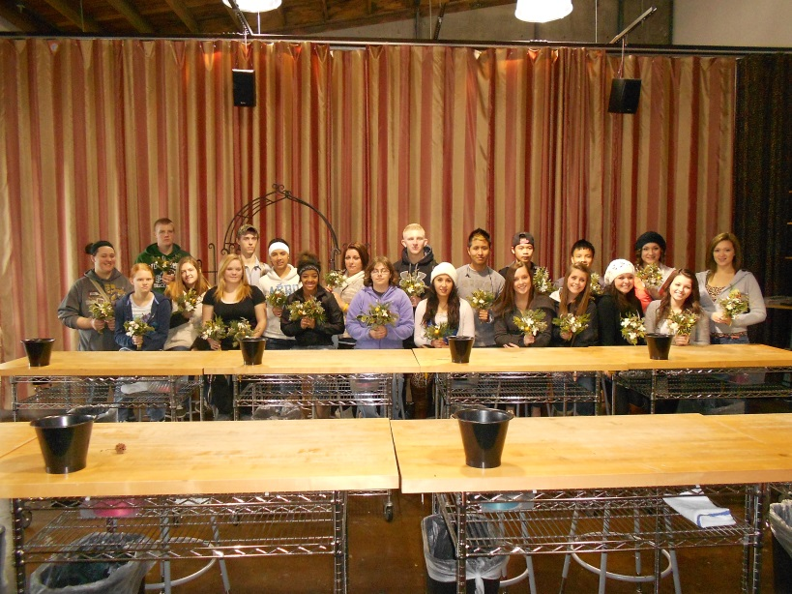
Future Farmers of America (FFA) CTSO

Slide 7
Arts, A/V Technology & Communications
Publishing

Slide 8
Business, management and Administration
Office Skills and Communications
Entrepreneurship

Slide 9
Information Technology
Web Design I & II
Computer Applications
Office User Specialist

Slide 10
Marketing
Marketing I and II
Retail Operations

Slide 11
Finance
Personal Finance

Slide 12
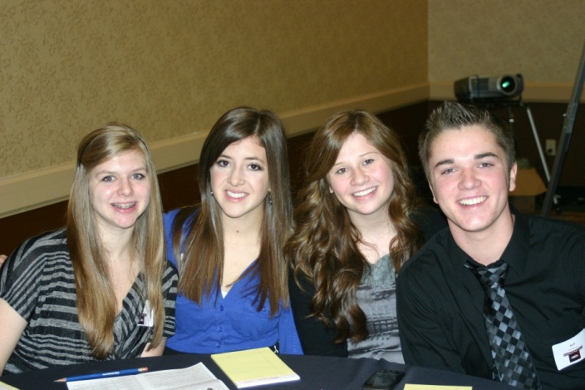
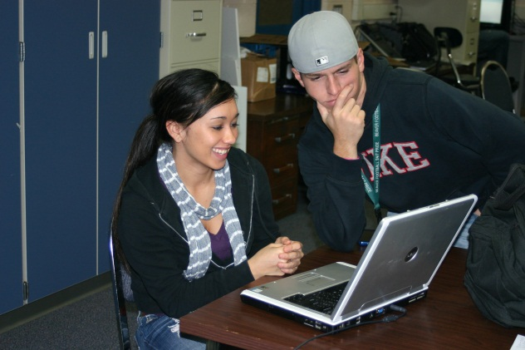
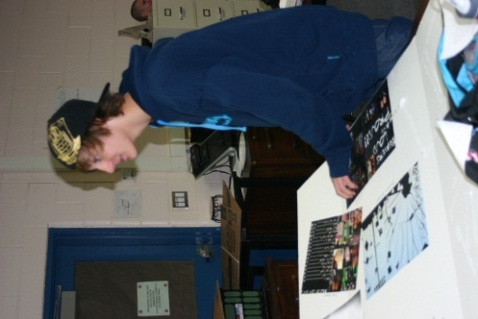
Future Business Leaders of America (FBLA) CTSO

Slide 13
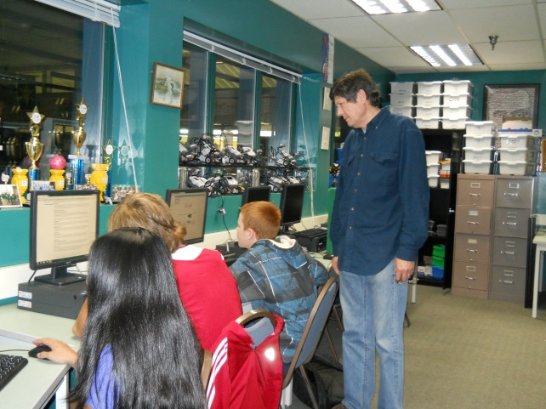
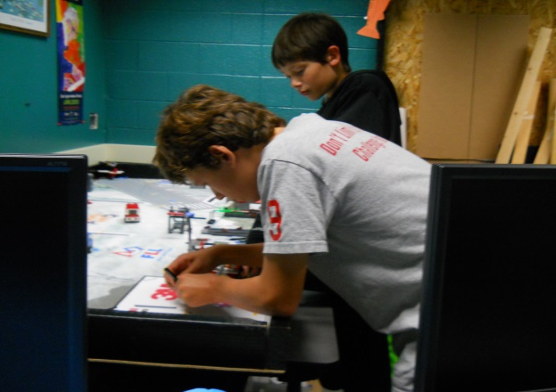
Science, technology, Engineering, & Math
LEGO Robotics
Advanced LEGO Robotics
LEGO Robotics Team

Slide 14
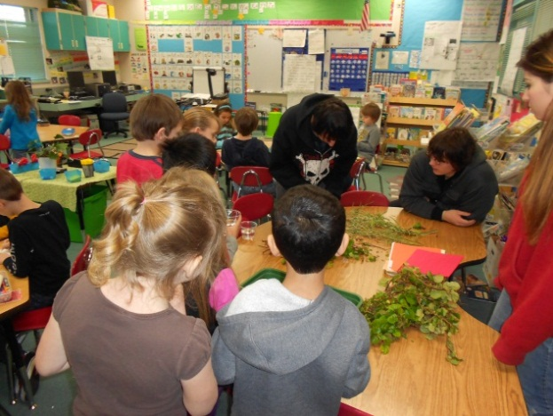
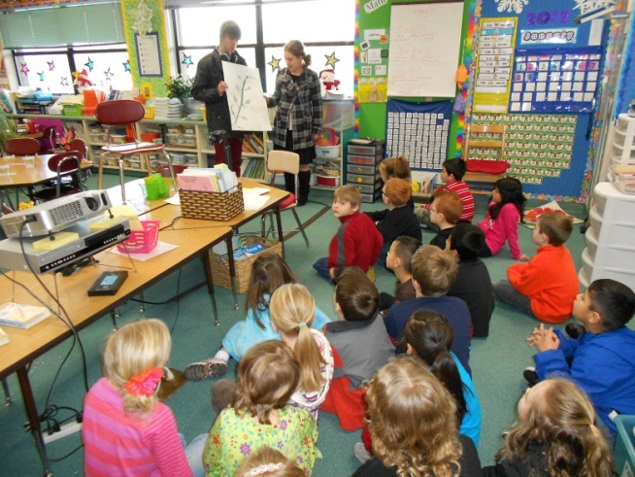
Education and Training
Human Services
Careers in Education
Early Childhood I & II

Slide 15
Hospitality and Tourism
Creative Chef I & II
Life Skills
Skills USA (CTSO)

Slide 16
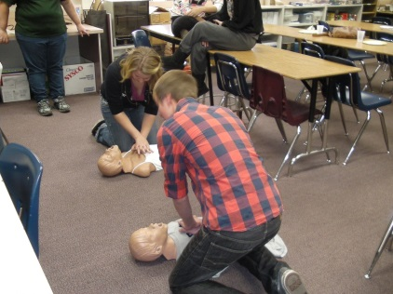
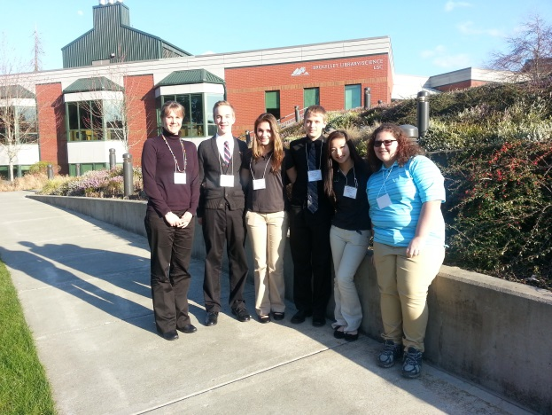
Health Science
Anatomy and Physiology I & II
Advanced Placement Biology
Health Occupations Students of America (CTSO)

Slide 17
Business and Marketing Pathway Offerings
Web Design I & II
Office Communications
Publishing
Entrepreneurship
Computer Applications
Personal Finance
Marketing I & II
Retail Operations

Slide 18
FASCE Pathway
Life Skills
Creative Chef I
Creative Chef II
Early Childhood I
Early Childhood II
Careers in Education

Slide 19
What do these kids do?

Slide 20
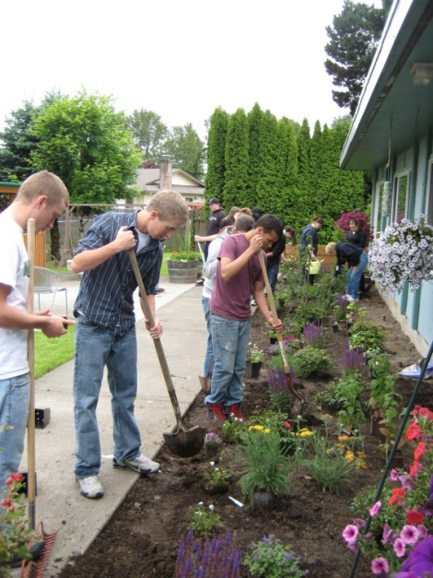
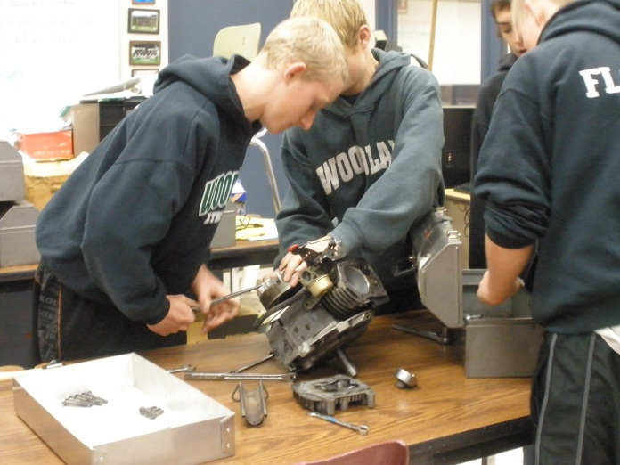
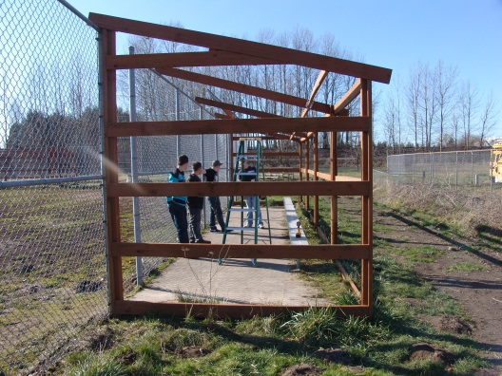
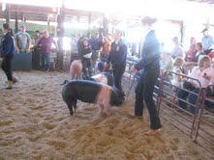
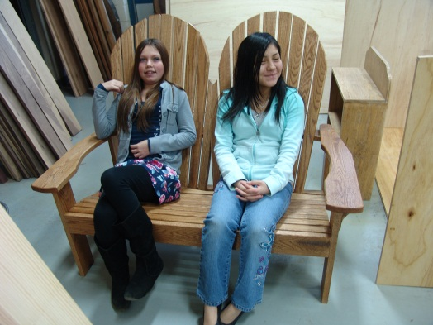
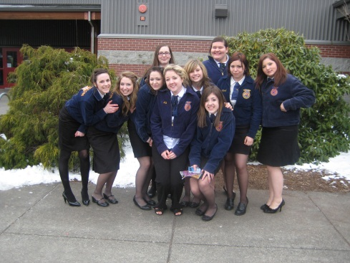
Future Farmers of America (FFA)
Agricultural and STEM Pathways CTSO

Slide 21
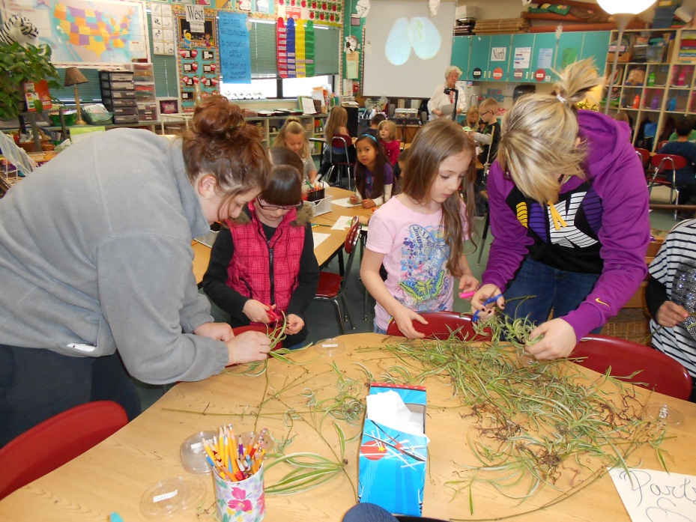
Early Childhood Education (FASCE Pathway)
Family, Career, and Community Leaders of America (FCCLA) CTSO

Slide 22
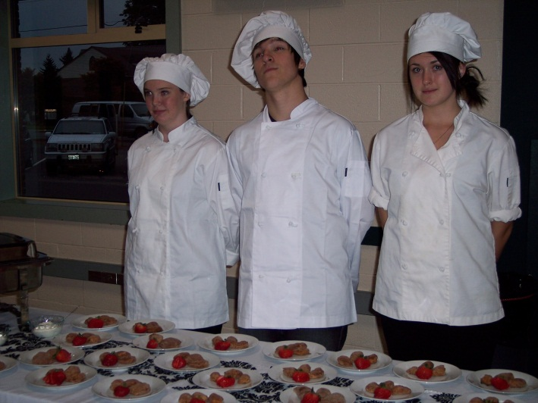
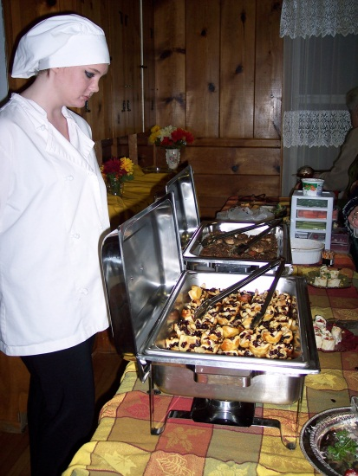
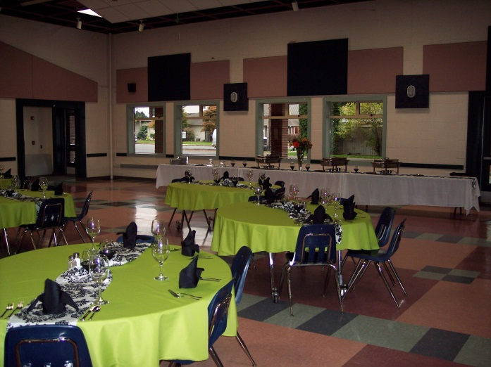
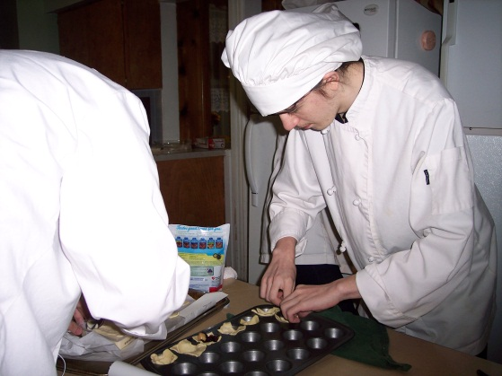
Creative Chef I & II (FASCE Pathway)
Skills USA CTSO

Slide 23
Current articulated Courses
WHS CTE Course
Community College Course
Computer Applications
Computer Applications
Web Design
Entrepreneurship
Beginning Metallurgy
Advanced Metallurgy
Beginning Mechanics
Advanced Mechanics
Anatomy and Physiology
Intro. to Business Tech.
Web Design
Entrepreneurship
Intro. to Oxy-acetylene
Intro. To Arc Welding
Intro. to small engines
Essentials of Mechanics
Basic Concepts of Anatomy and Physiology

Slide 24
Current Tech Prep Courses Cont.
WHS CTE Course
Community College Course
Early Childhood I
Early Childhood I
Early Childhood I
CAD
CAD
CAD
Introduction to Early Childhood
Child Development
Practicum I
Technical Drawing
Introduction to Drafting
Drafting

Slide 25
Current Industry Certifications
Microsoft Office Specialist (MOS)
Bronze Certified Technician (STIHL)
Food Handler’s Card
CPR
First Aid

Slide 26
Current Cross-Credited Courses
WHS CCTE Class
Cross-Credited Class
WHS Publications
Web Design II
Early Childhood I
Art
Art
Health

Slide 27
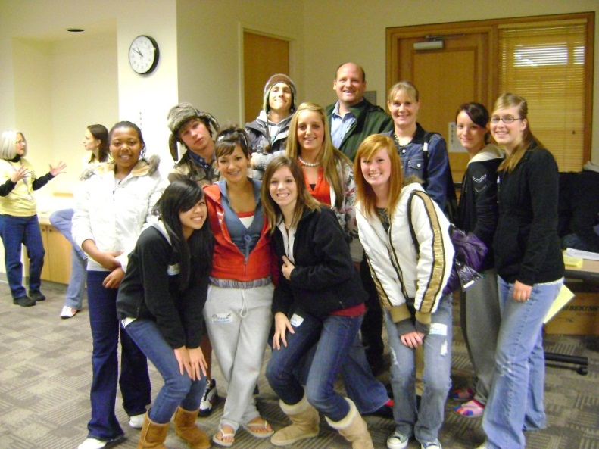
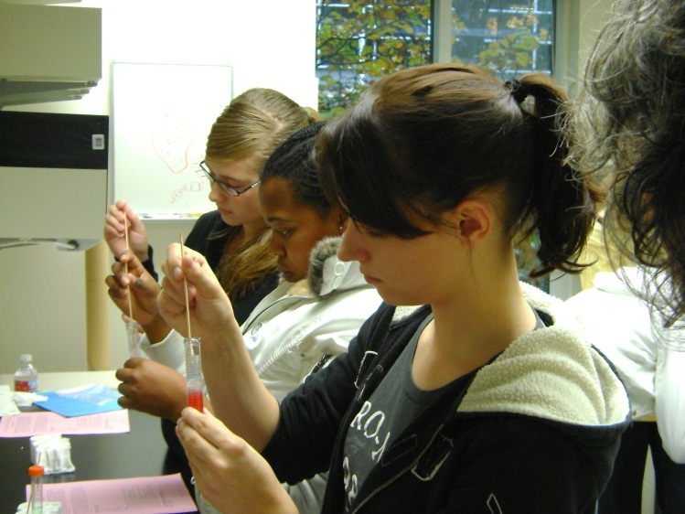
New for Next Year Health Sciences
Advanced Placement Biology
Anatomy and Physiology
Health Occupation Students of America (HOSA)- CTSO

Slide 28
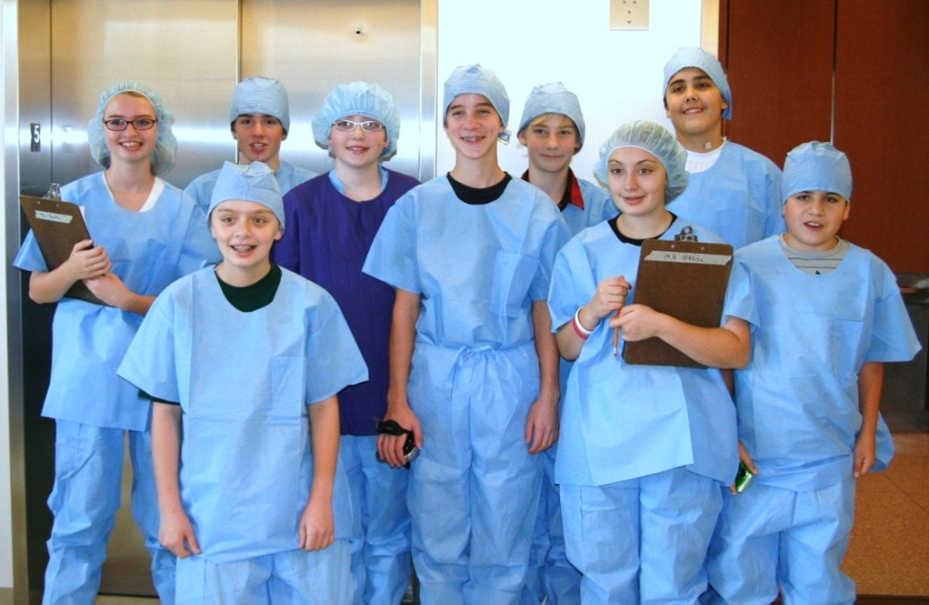
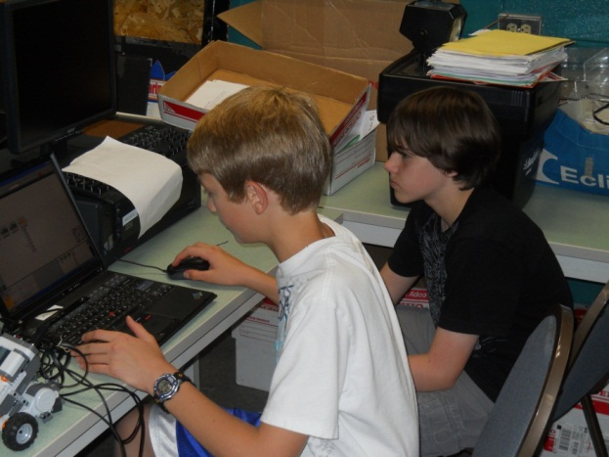
STEM Additions
Lego Robotics
First Tech Challenge
Technology Students of America (TSA) – CTSO

Slide 29
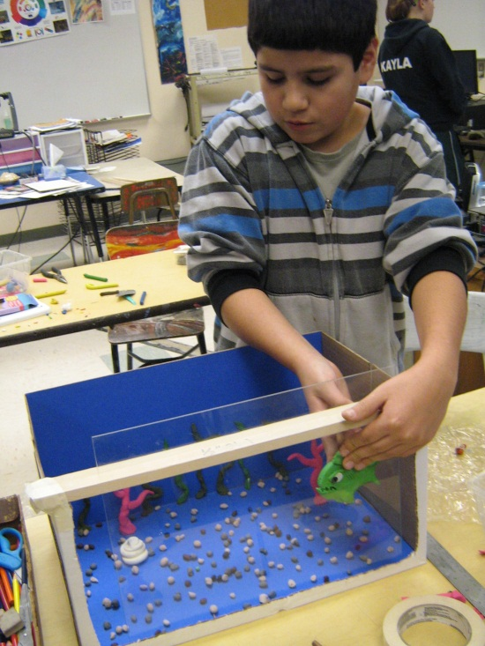
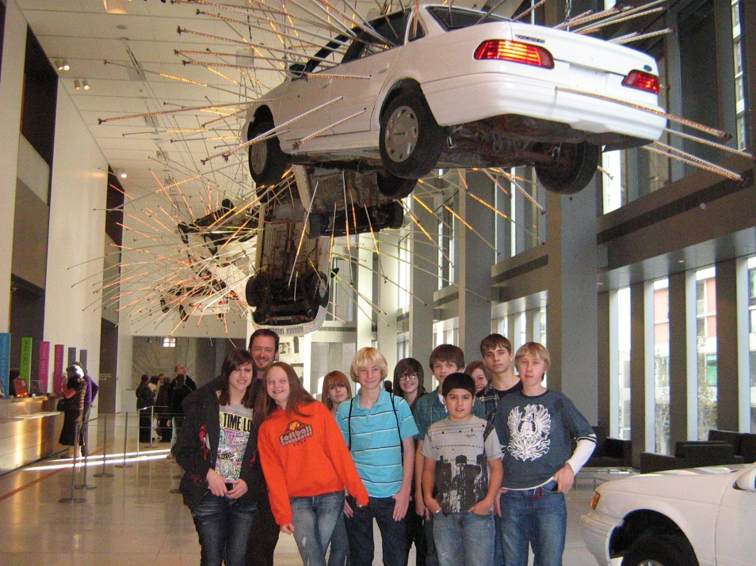
Audio and Video Technology Pathway
WMS Publications
WHS Photography
FBLA or TSA - CTSOs

